Slide 1
Interconnect Topologies
Nikhil Jain

Slide 2
Shared Memory
PE0
PE1
PE2
PEN
Memory
NO
Is anyone in charge of a part of memory?
Is there a notion of relative proximity?
No
May be

Slide 3
Not entirely true!
PE0
PE1
PE2
PEN
Network
Memory
Some part(s) of memory may be closer than others
What kind of network?
Switch
Bus

Slide 4
Distributed Memory Systems
PE0
PE1
PE2
PEN
Mem0
Mem1
Mem2
MemN
Others
Others
Others
Others
Locality of data is exposed
But beyond that…

Slide 5
Programmer’s View
PE0
PE1
PE2
PEN
Mem0
Mem1
Mem2
MemN
Rest of the System
Ring, Star, Butterfly, Mesh, Torus, Tree..
How is the rest of the system connected?
Why do I care?
PERFORMANCE

Slide 6
Commonly Discussed Network Topologies
Slide from a lecture by Prof Heath

Slide 7
Commonly Discussed Network Topologies
Slide from a lecture by Prof Heath

Slide 8
Commonly Discussed Network Topologies
Multi-tier all-to-all

Slide 9
Basic Topology requirements
For things to work
Must connect each processor to all others. i.e. it should be possible to send “messages” between any pair of processors
Must allow for physically viable arrangements (try arranging a star for thousands of processors)
The physically viable arrangement should be economically affordable

Slide 10
Basic Topology requirements
For things to work well:
Intermediate routing, if needed, should happen without interfering with computation on intermediate nodes.
Reasonable path length between every pairs of processors
Easy to calculate path from one processor to other
More discussed later…

Slide 11
Topology Basic definitions
Let the topology be represented by a Graph G(V,E) where V is the set of vertices - processors/routers and E is the edges - connections among them
degree: maximum number of edges incident on a vertex
distance between two vertices: number of edges (hops ) in shortest path between them
diameter: maximum distance between any pair of vertices
edge length : maximum physical length of any wire; may be constant or variable as number of processors varies
bandwidth

Slide 12
How to Judge a Topology
degree: affects capability to communicate simultaneously
diameter: determines the maximum delay
average distance
link bandwidth: impacts how fast communication is done
bisection bandwidth
Divide the set of processors in two equal partitions
How much link bandwidth is available for data flow from one partition to the other? – Minimize it
Important for global communication, congestion

Slide 13
Fully Connected Network
degree:
diameter:
average distance
total links/link bandwidth:
bisection bandwidth:
What if everyone wants to send data to every one else?
Does this look like an overkill?
P-1
1
1
P(P-1)/2
B.P.P/4

Slide 14
Chains
degree:
diameter:
average distance
total links/link bandwidth:
bisection bandwidth:
Single point of failure!
Asymmetric – not a good idea
1-2
P-1
P/3
P-1
B

Slide 15
2D Meshes (say P = k * k)
degree:
diameter:
average distance
total links/link bandwidth:
bisection bandwidth:
Asymmetric – not good!
Bisection bandwidth is decent: can be n-dimensional
2-4
2(k-1)
2k/3
2k(k-1)
kB

Slide 16
Slide from a presentation by Prof. Dr.-Ing. Axel Hunger

Slide 17
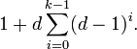
Are Hypercubes optimal? Moore Graphs
Moore bound: given degree d and diameter k, the largest number of nodes a graph can have is:
Conversely, given n vertices, and degree d, the best diameter we can hope for is: k = log_{(d-1)}(n)
Given n = 1000, d = 10, k >= 4
A Moore graph has the maximum number of vertices possible among all graphs with maximum degree d and diameter k.

Slide 18
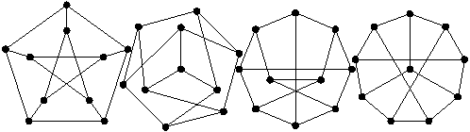
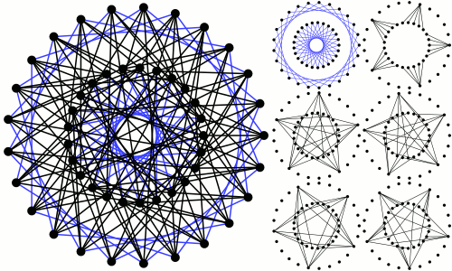
Known Moore graphs
Peterson Graph: 10 vertices, degree = 3, diameter = 2.
Singleton graph: 50 vertices, degree = 7, diameter = 2
A 3rd graph might possibly exist, of degree 57!

Slide 19
Why did Hypercubes Die?
Disadvantages of hypercube?
Wire lengths? May span the entire machine
Leads to reduced bandwidth per link, unless its optical
Copper vs optical interconnects:
Copper is cheaper but constrained by length
Number of connections per node increases with the size of the machine
K-ary n-cube allows one to seek intermediate points between meshes and hypercubes.
N-dimensional “hyper” cube, but number of processors along each dimension is k (instead of 2 of binary hypercube)

Slide 20
Rings (k-ary 1-cube, or wrapped chain)
degree:
diameter:
average distance
total links/link bandwidth:
bisection bandwidth:
Why did I draw ring as a circle?
What if everyone wants to send data to every one else?
2
P/2
P/4
P
2B

Slide 21
2D Torus (k-ary 2-cube)
degree:
diameter:
average distance
total links/link bandwidth:
bisection bandwidth:
Bisection bandwidth is decent
But other issues, beyond the scope of this lecture
4
k-1
k/2
2k*k
2kB

Slide 22
k-ary n-cube
P = k * k * k *…. Or P = k1 * k2 * k3 * ….
Degree = 2n
Diameter = n*k/2
Average Distance = n*k/4
Bisection Bandwidth = 2B*P/k

Slide 23
Multi-tier Networks
Multi-tier all-to-all

Slide 24
Switches and Indirect networks
switch
node
switch
switch
switch

Slide 25
Slide from a presentation by Prof. Dr.-Ing. Axel Hunger

Slide 26
Slide from a presentation by Prof. Dr.-Ing. Axel Hunger

Slide 27
Butterfly
For P processors, log p ranks with p switches
Node(i,j) is connected to two nodes with rank i-1 – node(i-1,j) and node(i-1,m) where m is the integer found by flipping the i^{th} most significant bit in binary representation of j
Rank 3 vertices can be processors/memory

Slide 28
Butterfly
Routing is simple: follow the binary
0 means ship left;
1 means ship right.
diameter: log P
Average distance log P
bisection: P/2
What is not good?

Slide 29
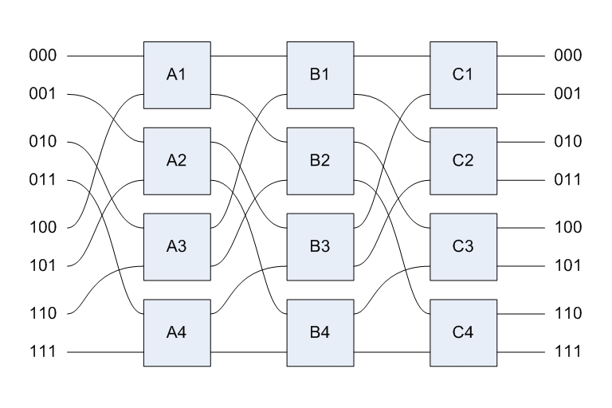
Omega networks

Slide 30
Fat Tree/Clos Topology
a)
b)
4-ary 1-tree
4-ary 2-tree
c)
4-ary 3 tree

Slide 31
Summary

Slide 32
Things to explore
Which network suits which type of communication?
Find the networks used in modern machines – Mira, Blue Waters, Stampede, Tianhe, K computer.
How does one embed one topology in another topology?
How would you connect processors?

